Slide 1
Automatic Email Sending Using Python
-DIVINE P

Slide 2
🎯 1. OBJECTIVE :
To automate the task of sending multiple emails using Python.
Reduce manual effort and human error in email communication.
Utilize Excel for managing recipient data.
Personalize messages dynamically for each recipient.
Ensure reliable, timely, and efficient communication.

Slide 3
🧪 2. PROOF OF CONCEPT (POC):
An Excel file contains names and email addresses of recipients.
Python script reads this file using the pandas library.
Emails are sent automatically via smtplib using SMTP.
Console outputs confirm successful sending.
Recipients receive personalized emails as per the Excel data.

Slide 4
🧠 3. Design and Methodology (Point View):
Step 1: Prepare an Excel sheet with recipient details.
Step 2: Use pandas to read the Excel file.
Step 3: Connect to an SMTP server using smtplib.
Step 4: Compose and personalize each email.
Step 5: Send emails in a loop and log success.
Step 6: End connection after completion.

Slide 5
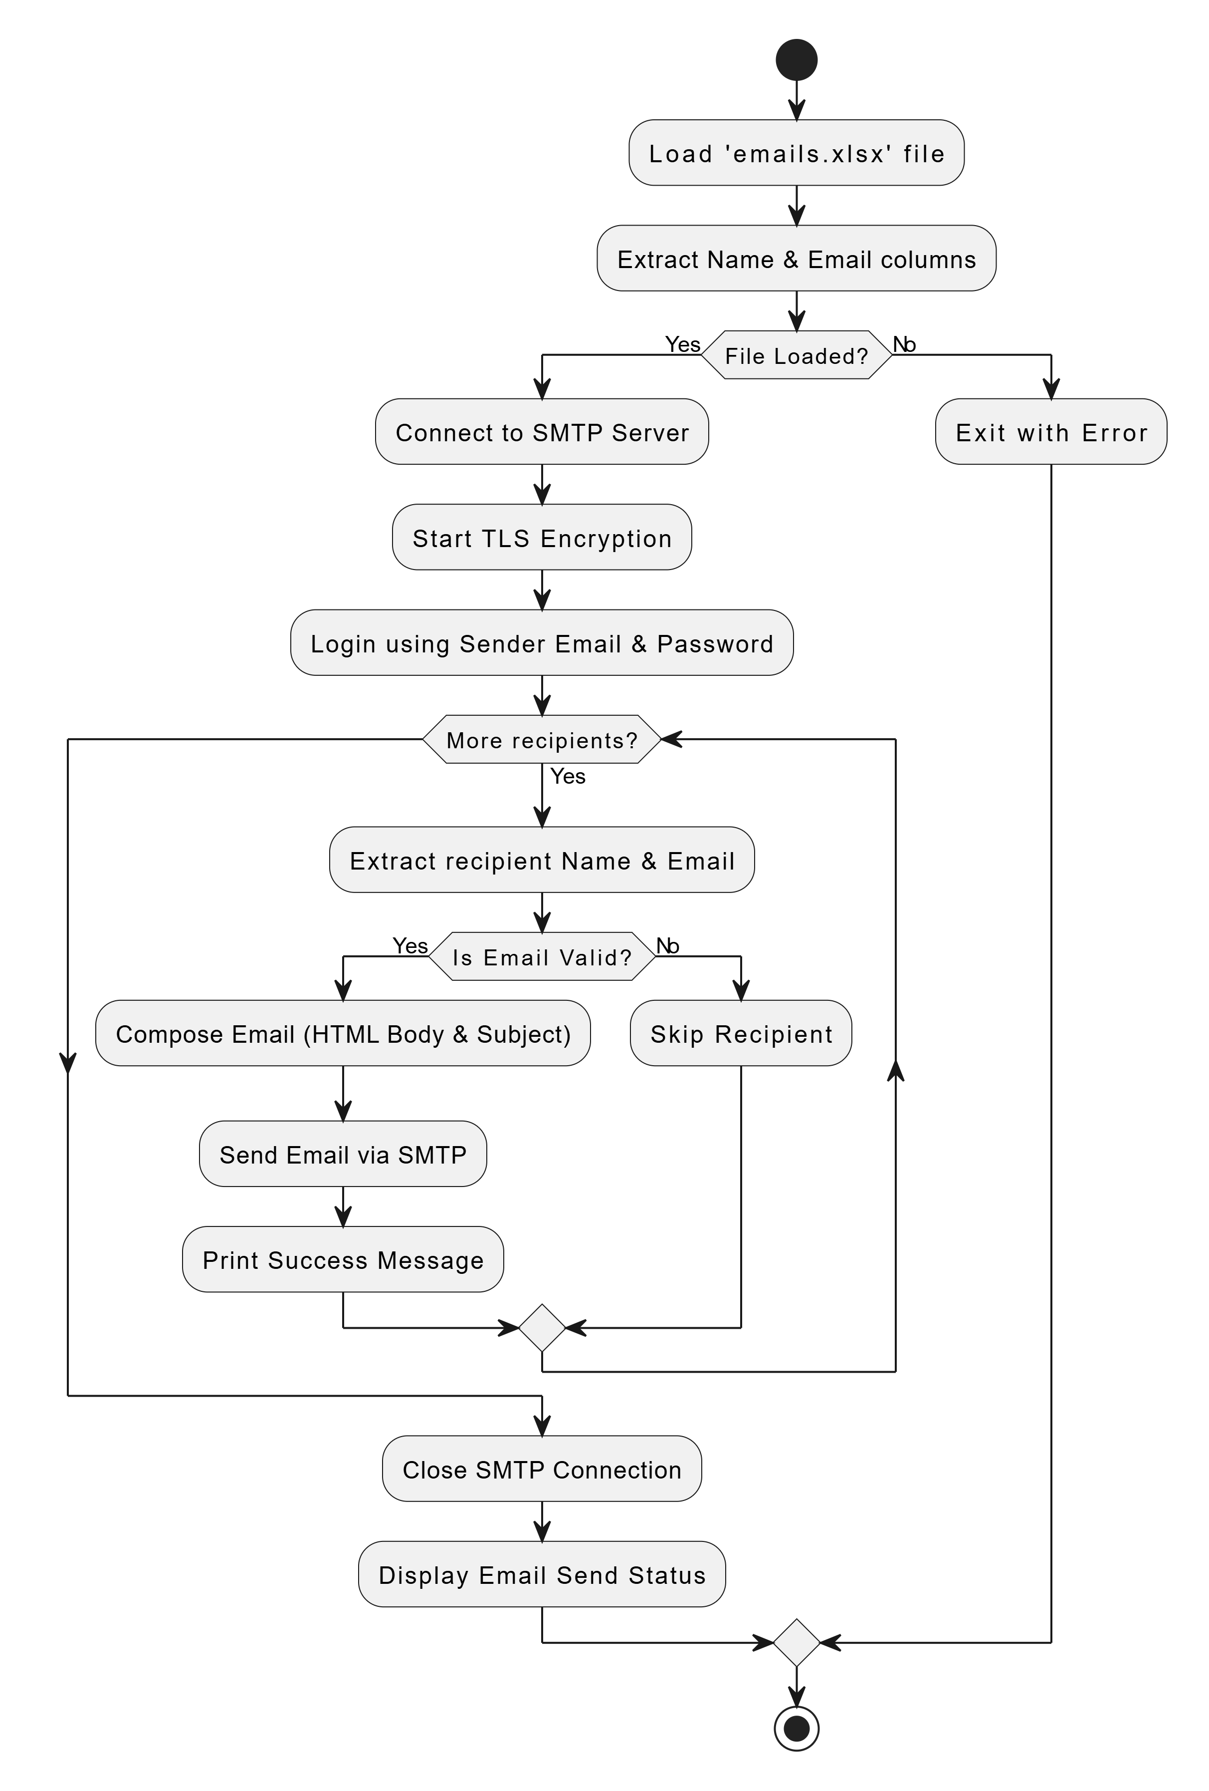
FLOWCHART:

Slide 6
💻 5. SOFTWARE AND LIBRARIES USED:
Python 3.x – Main programming language
VS Code – IDE
Excel – For storing email and name data
Libraries Used:
  pandas – Reading Excel file
  openpyxl – Excel backend support
  smtplib – Sending email via SMTP
  email.mime – Formatting email content

Slide 7
CODE:

Slide 8
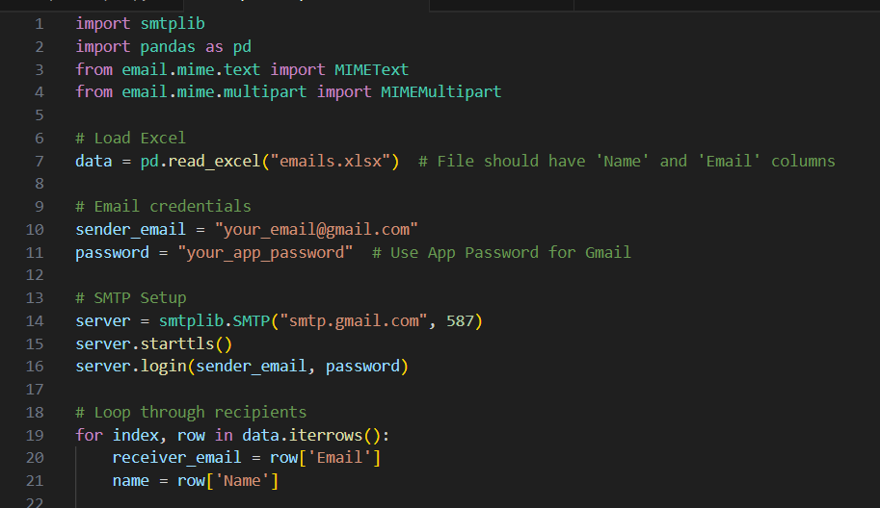

Slide 9
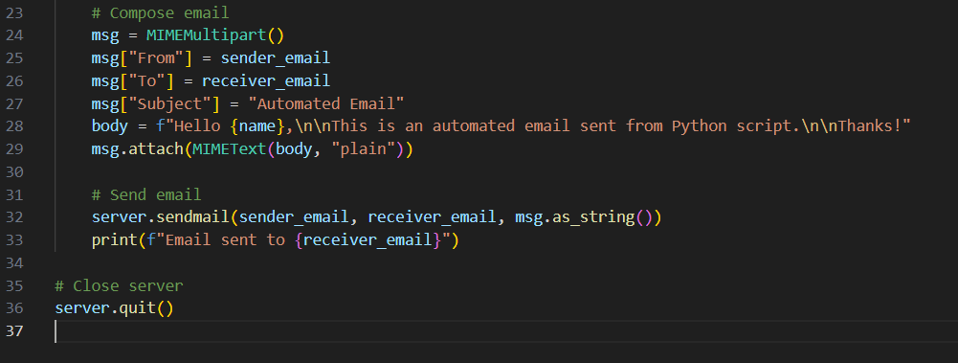

Slide 10
📝 7. DESCRIPTION OF CODE :
Imports necessary libraries.
Reads Excel data using pandas.
Connects to Gmail SMTP server securely.
Loops through each recipient.
Composes personalized message.
Sends email and prints status.
Closes connection once done.

Slide 11
📈 8. RESULT
Emails are sent to all recipients in the Excel sheet.
Each recipient receives a personalized message.
Console shows confirmation for each email sent.
No manual effort needed for sending bulk emails.
Project successfully proves the concept of automation.

Slide 12
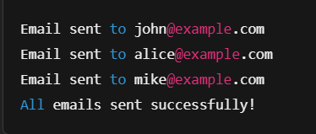
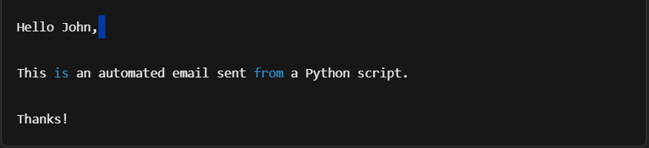
OUTPUT:
Example of Email Received:

Slide 13
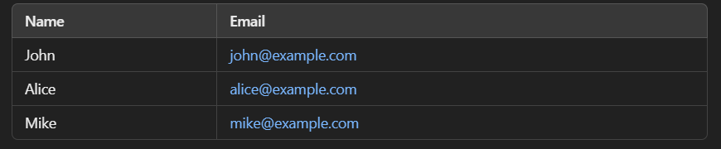
📌 Screenshot of Excel File (emails.xlsx):
📌 Screenshot of Sent Items (Gmail)
✅ "Automated Email" sent to:
john@example.com
alice@example.com
mike@example.com

Slide 14
📦 9. Application :
College: Send announcements to students/staff.
Companies: Email reports, reminders, payslips.
Marketing: Bulk promotional or newsletter emails.
Events: Auto-invite participants with custom messages.
Schools: Notify parents or students automatically.

Slide 15


